Slide 1
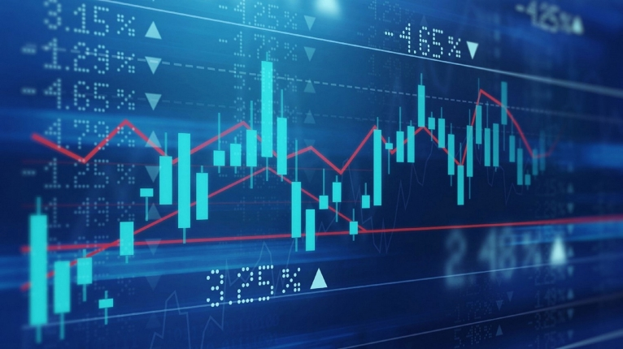
AI-Powered Stock Market Prediction Using Machine Learning and LSTM
By: Travis Johnson
Notes:
Hi everyone, my name is Travis Johnson, and this is my final project on stock market prediction using Machine Learning

Slide 2
Problem Statement & Objective
Investors face difficulty predicting market trends due to volatility and complexity. This Project builds multiple ML Models to Predict the stock chosen, which was Apple (AAPL).
Testing Assets
Historical Stock Data
Economic Indicators
News Sentiment
ML Models
Linear Regression
XGBoost
Long Short-Term Memory (LSTM)
Notes:
Predicting stock prices is difficult due to constant volatility and market sensitivity to external factors.
In this project, I tested how well machine learning models can predict Apple’s stock using three categories of data: historical stock prices, macroeconomic indicators, and public sentiment from news.
I compared three models: a simple Linear Regression, XGBoost - which handles non-linear relationships better - and LSTM, a deep learning model designed for time-series prediction.

Slide 3
Research Literature & Modeling Approach
Referenced academic papers and financial forecasting models.
Goal: Test which model best captures stock dynamics.
Key Techniques
Lag feature creation (t-1, t-2, t-3)
Integration of Federal Reserve Economic Data (FRED) data
VADER-based Sentiment Scoring
Notes:
My methodology was inspired by academic research that successfully used lag features - past prices from 1 to 3 days ago - along with economic data to forecast prices.
I pulled economic data from the website FRED and scored sentiment using VADER.
The goal was to test which model best learns from patterns over time, especially with economic and news context included.

Slide 4
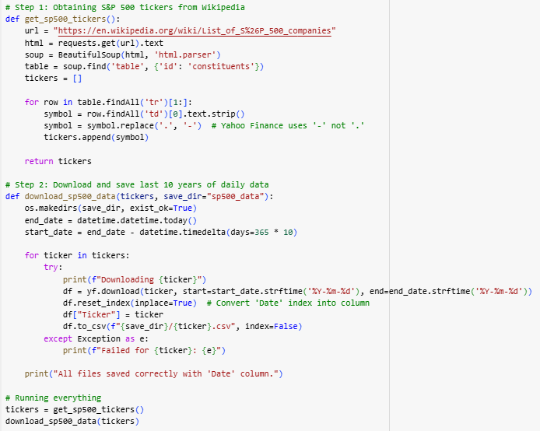
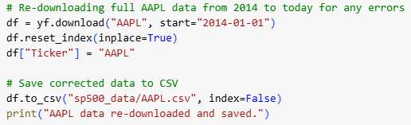
Data Collection S&P 500
Collecting the Stock Data for the last 10 years for every company listed on the S&P 500
Notes:
To get robust stock data, I used Python to scrape and download daily OHLCV data for all companies in the S&P 500 for the past 10 years.
OHLCV stands for Open, High, Low, Close, and Volume
While I focused on Apple for modeling, this larger dataset allowed flexibility and scalability for future testing.

Slide 5
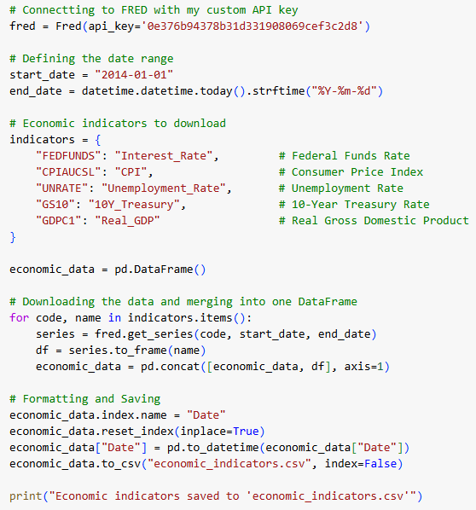
Data Collection from FRED
Collecting the Economic Data from the Federal Reserve Economic Data (FRED) Website
Notes:
For macroeconomic signals, I used the FRED API to download indicators like interest rates, CPI, unemployment, and real GDP.
These were merged with the stock data by date, allowing the models to learn relationships between macroeconomic trends and stock movement.

Slide 6
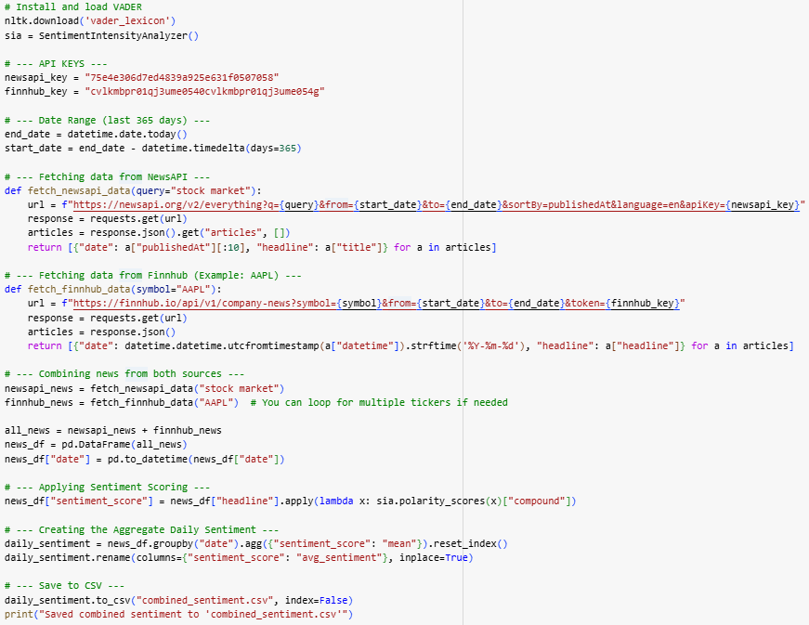
Economic Sentiment Collection
Collecting the Economic Sentiment from NewsAPI, and Finnhub for my Vader scoring
Notes:
I also explored incorporating sentiment from news headlines.
Using NewsAPI and Finnhub, I scraped recent headlines about the stock market and AAPL.
I then used the VADER tool to assign daily sentiment scores, which were merged with my economic and price datasets.

Slide 7
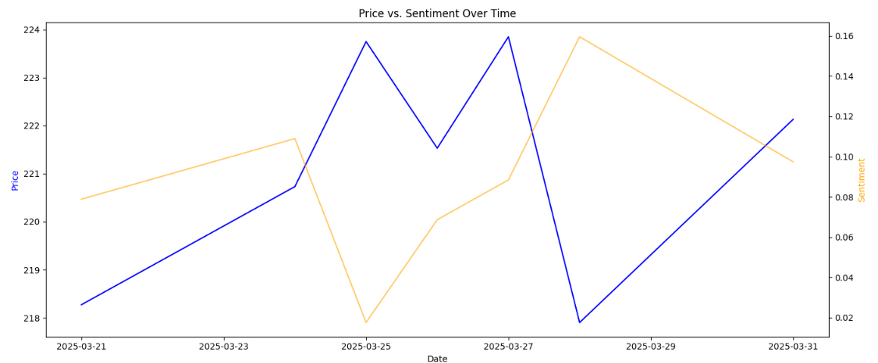
Exploratory Data Analysis
Correlation between News sentiment and actual stock price for AAPL
Notes:
This visualization shows a sample correlation between daily sentiment and AAPL’s closing price.
While the relationship isn’t perfectly linear, you can see how sentiment leads price movement.
This confirmed the idea that adding sentiment might add predictive value.

Slide 8
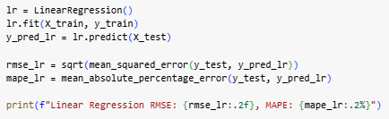
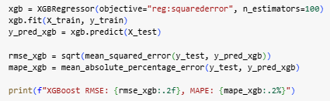
Methodology
Models Trained
Linear Regression (Baseline)
XGBoost (Nonlinear, robust)
LSTM (Sequential time-series model)
Data Preprocessing
Normalization
Test/Train Split (80/20)
Linear Regression Code
XGBoost Code
Notes:
Here’s how I structured the modeling.
First, I normalized the data and used an 80/20 train-test split.
The baseline was Linear Regression.
I then trained XGBoost for its non-linear capability, and finally an LSTM model to capture time-series memory.
Each model predicted the next-day closing price, and performance was evaluated using RMSE: Root Mean Squared Error and MAPE: Mean Absolute Percentage Error

Slide 9
Results & Insights
Model Comparison
Linear Regression → RMSE: 4.28, MAPE: 3.24%
XGBoost → RMSE: 3.12, MAPE: 2.15%
LSTM → Promising results but it needs more tuning for the data to be valuable
Insights
The Economic indicators improved overall accuracy
XGBoost captured nonlinearity better than the linear models
Notes:
These are my final results:
Linear Regression gave decent performance, with RMSE of 4.28.
XGBoost outperformed it with RMSE of 3.12 and a lower error rate overall.
LSTM showed promising results but needs more tuning.
Insights: adding economic indicators definitely improved accuracy, and XGBoost was the most effective at capturing complex relationships in the data.

Slide 10
Conclusion & Future Work
The Models show a strong potential for accurate market prediction
Time-series and feature engineering are crucial for overall performance
Future Improvements
Keep tuning the LSTM Model until it can deliver consistent data
Incorporate Real time streaming data
Research more stocks
Notes:
In conclusion, ML models - especially tree-based models like XGBoost - are effective at predicting stock trends. Economic indicators had a measurable impact on performance, and LSTM could be more competitive with additional tuning and data. In the future, I’d like to:
Tune the LSTM further,
Incorporate real-time data streaming
Expand to multiple stocks to generalize performance.

Slide 11
Questions?
Notes:
I will now open up to questions

